Slide 1
Used for highlighting a key portion of portion of the user interface
Menus
Used for highlighting a step (step 2 in this example)
2
All screenshots from PowerPoint taken with zoom level in PowerPoint at 100%
All screenshots from other applications are scaled to 75% in PowerPoint. Other scales can be used when necessary for clarity.
User Task
Decision
Yes
Program Task
Start
End
No
+
Fork/Join

Slide 2
Start
Select Region (where)
Select Time Period
(when)
Select Variable(s)
(what)
Filter Results
Save Theme
End

Slide 3
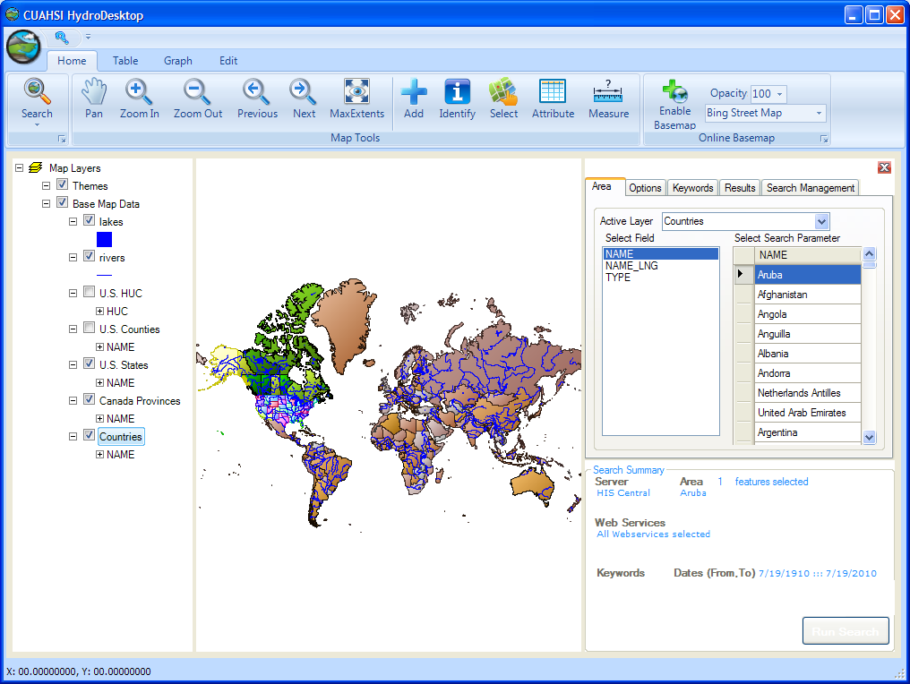
Ribbon
Map
Map Layers
Data Search

Slide 4
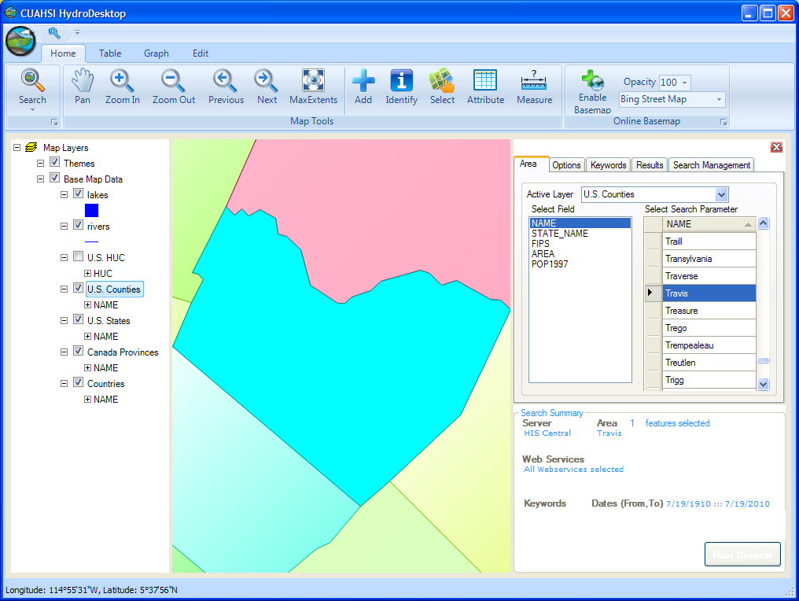
1
3
2
4

Slide 5
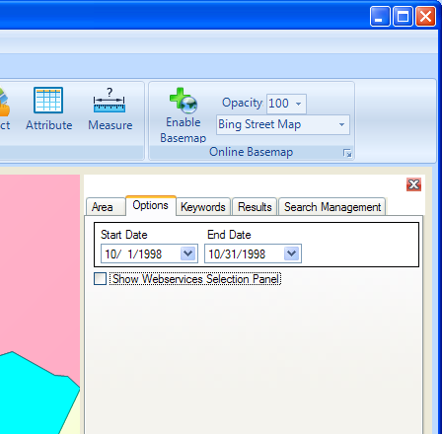
5
6

Slide 6
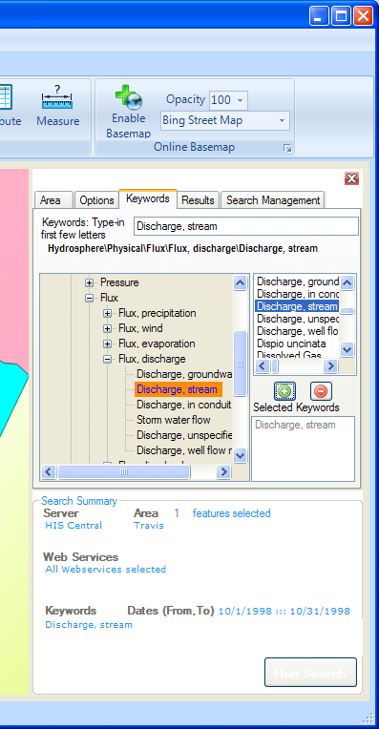
7
8
9
10
11

Slide 7
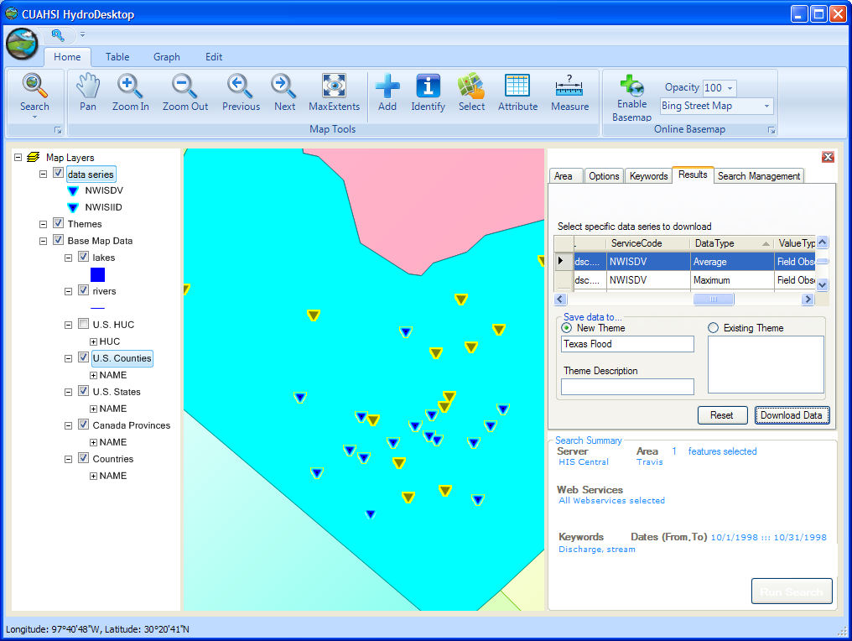
13
14
12
15
16

Slide 8
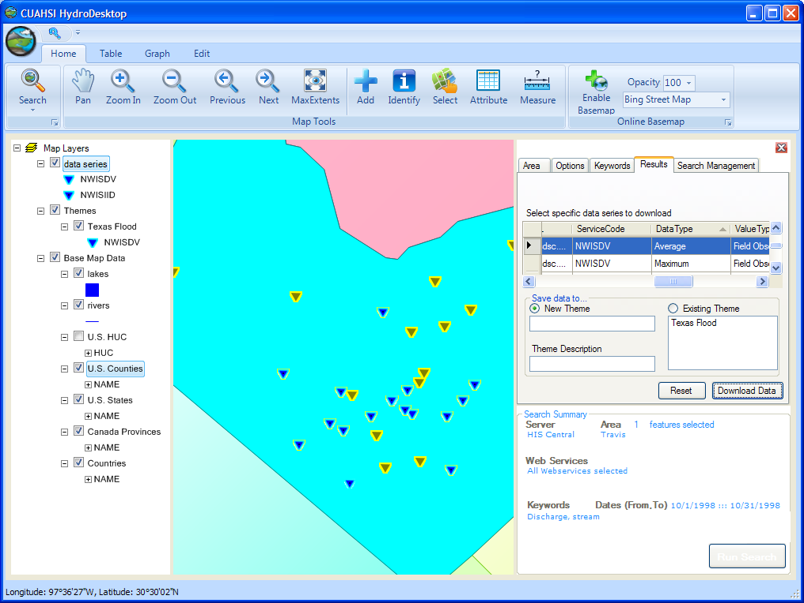

Slide 9
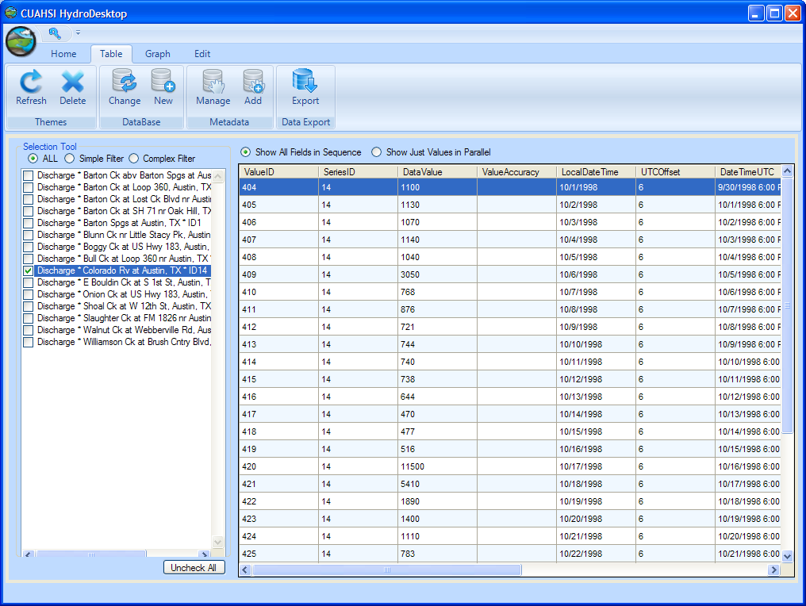
1
2

Slide 10
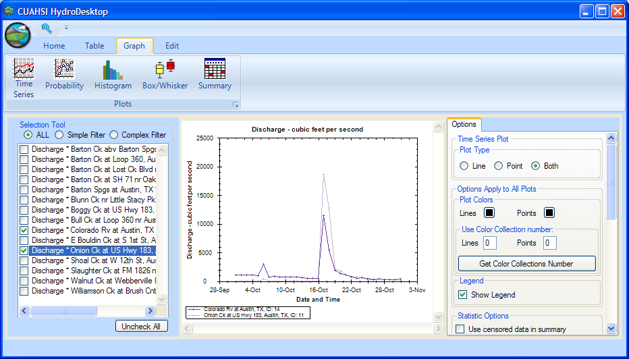
3
4

Slide 11
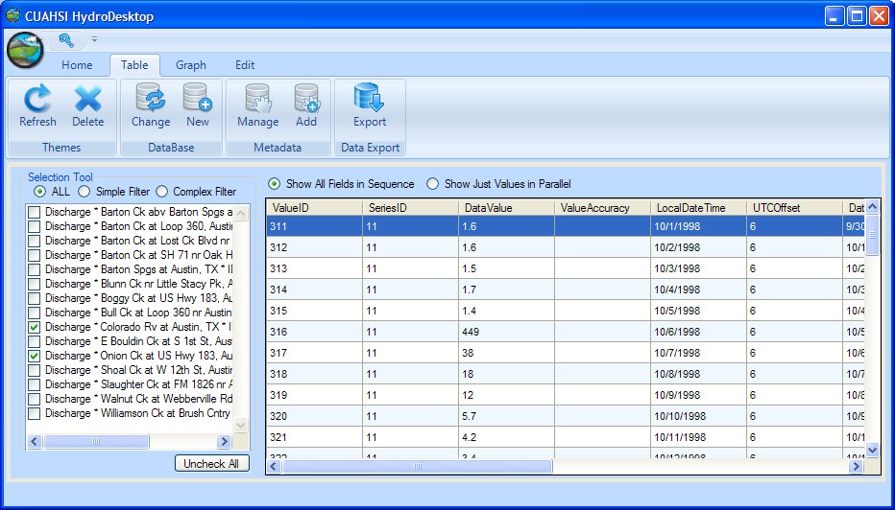
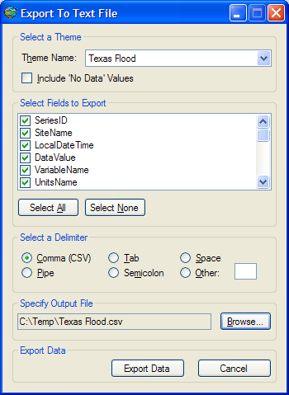
1
2
3
4

